Slide 1

Priority Areas for Reforestation
Martin Sanchez (October 28, 2018)
Presented to:
Thinking Machines
Data Science
Analyzing vulnerability as a function of impact and adaptative capacity in order to classify
priority areas for reforestation on regions affected by Typhoon Odette.
Presented by:
Mark Anthony A. Cabanlit
Notes:
Hello everyone, good afternoon.
I am Marky and for this presentation I am going to be identifying priority areas where the reforestation program could be implemented in areas recently devastated by Typhoon Odette. If you have any questions feel free to ask me during the presentation but I will also be answering questions after the presentation.
Martin Sanchez (October 28, 2018)
https://unsplash.com/photos/ML6kHR--Uys

Slide 2
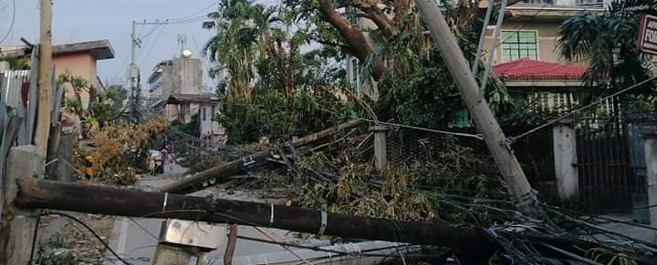
Introduction
Viviana Rishe (August 9, 2018)
Mark Cabanlit (2021)
On 16 December 2021, Typhoon Rai (local name Odette) brought torrential rains, violent winds, landslides, and storm surges in the provinces of Surigao del Norte and Dinagat Islands in Mindanao, in five provinces of Visayas, and in the island of Palawan in Luzon before it exited the Philippine area of responsibility on 17 December. –UNHCR
Notes:
On December 16, 2021, Typhoon Odette brought heavy rains, extremely violent winds, landslides and storm surges in the provinces of Surigao del Norte and Dinagat Islands in Mindanao, the island of Palawan in Luzon and five provinces in Visayas including where I am today.
I am currently in Cebu and we were one of the affected areas by the Typhoon and I remember about 7pm all the lights were already out, and I was still about to finish work at that time so it was undertime for me. And then the winds have started going crazy at about 11pm, we live in an area that most people would describe as “squatters” but it just means your cramped up living areas wherein a lot of filipinos live. At around 11am my brother and I became the lookout and you can really see from the dark that our neigbor’s roof has been slowly taken by the storm. You can’t even help them because you can’t contact anyone anymore because there was no signal already at that time and you can’t go out because the risk of being hit by a flying roof are high. The winds stopped around 2am so we started cleaning up, slept a bit and woke up to the sight of horror. I wanted to cry but people around me had already started cleaning up, reparing their houses so I did what I had to do and started helping out. Lucily our roof was still complete. But our garden (roof included) is gone. No electricity, no water, no signal, no internet and long queues for gasoline and atm was the theme for both our Christmas and New Year.
Viviana Rishe (August 9, 2018)
https://unsplash.com/photos/QAFp7YhT-4Q

Slide 3
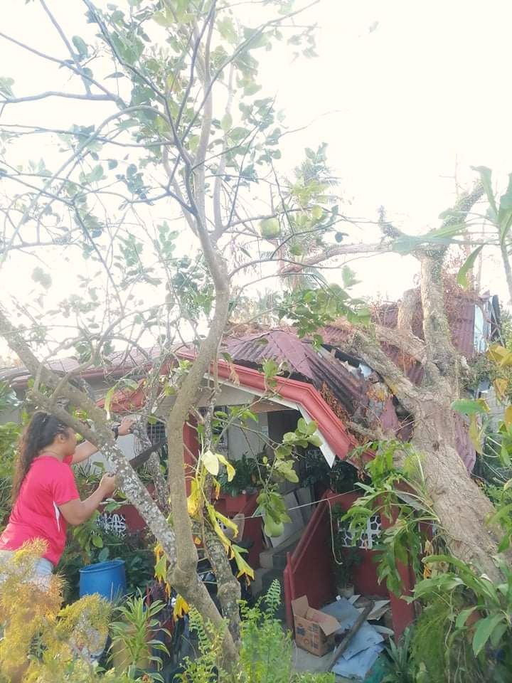
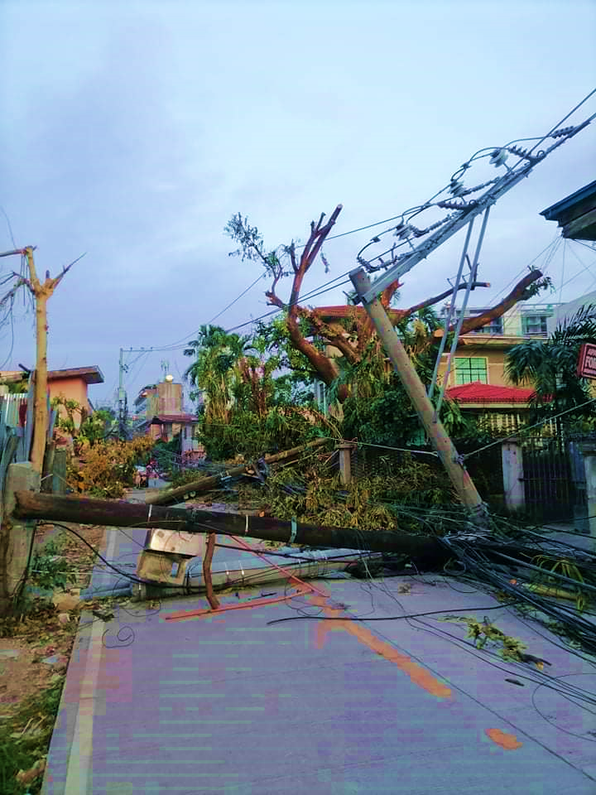
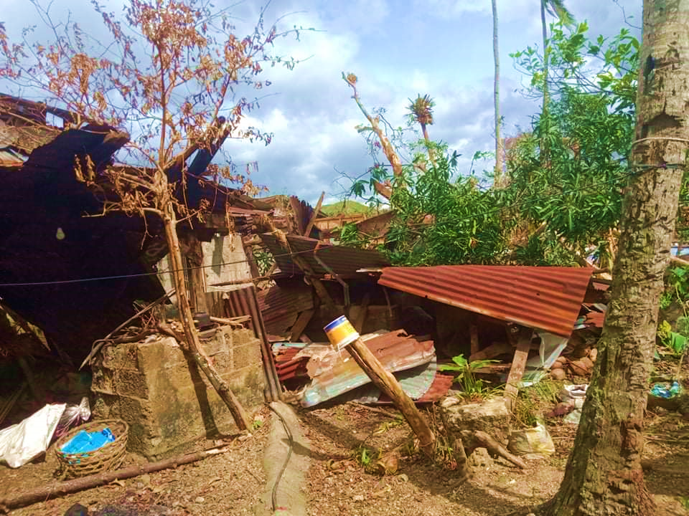
Super Typhoon Odette (Rai)
Almost 5 months after the typhoon, I am glad to say that we are slowly recovering from the damages brought about by the typhoon.
According to NDRRMC, there have been 2,276,535 affected families, 405 deaths, and almost 2M damaged houses.
A lot has changed most specially in the rural areas, almost no shade can be seen since most trees have been toppled down by the Typhoon and that includes the tree that destroyed our house.
Although a few of the houses have already been repaired within the span of a few months, unfortunately other factors such as trees would require more time to recover.
Mark Cabanlit (2021)
Notes:
Almost 5 months after the typhoon, I am glad to say that we are slowly recovering from the damages brought about by the typhoon.
According to NDRRMC, there have been 2,276,535 affected families, 405 deaths, and almost 2M damaged houses.
A lot has changed most specially in the rural areas, almost no shade can be seen since most trees have been toppled down by the Typhoon and that includes the tree that destroyed our house in the province.
Although a few of the houses have already been repaired within the span of a few months, unfortunately other living things such as trees would require more time to recover.
Front of our hose with the huge tree, lower is back of our house
And then the fallen post is my way to work.

Slide 4
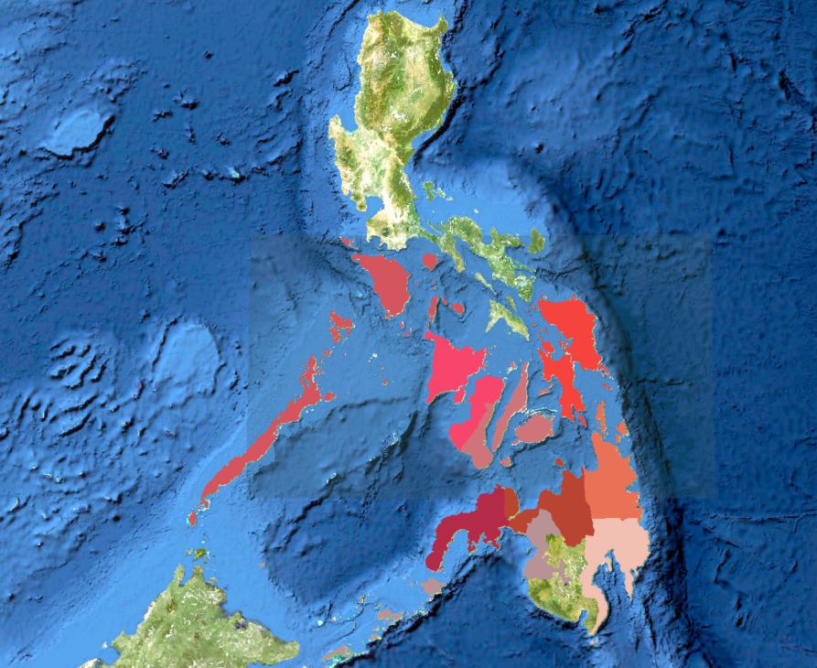
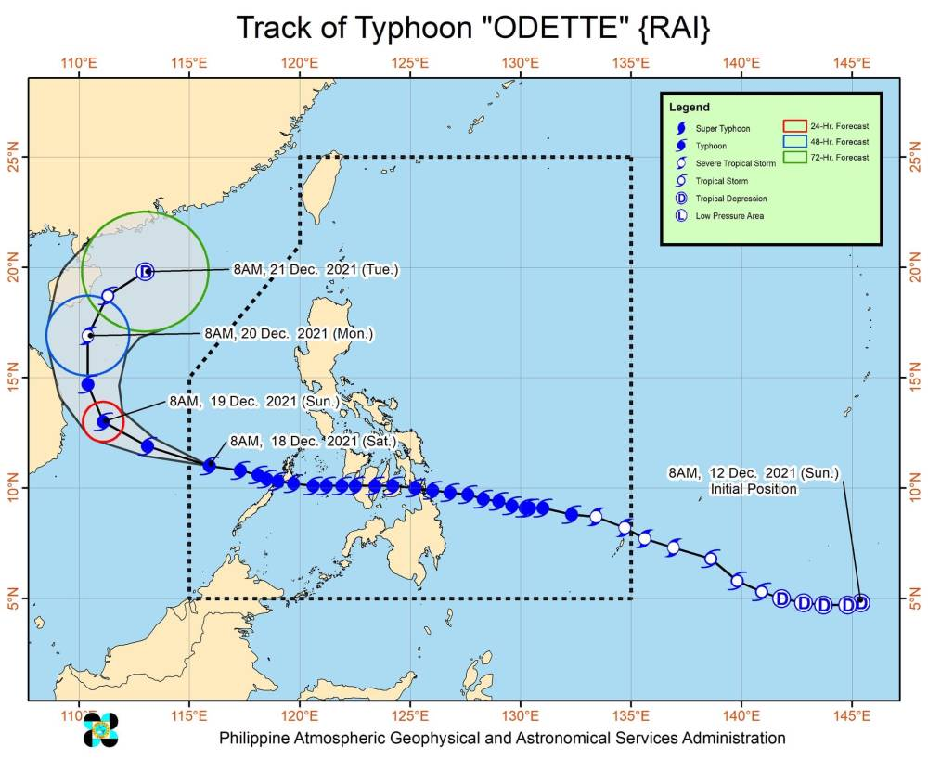
Study Area
The image on the left shows the path of Typhoon Rai when it passed the Philippines.
Notes:
Let’s now proceed with the analysis, so for our study area, we can use the image on the left which is the track of Typhoon Odette as on of our references.

Slide 5
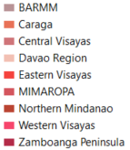
Study Area
The image on the left shows the path of Typhoon Rai when it passed the Philippines.
The regions that were affected includes: BARMM, CARAGA, Central Visayas, Eastern Visayas, Western Visayas, Zamboanga Peninsula, Northern Mindanao and Davao Region.
Notes:
The regions that were affected includes: Bangsamoro Autonomous Region in Muslim Mindanao, CARAGA, Central Visayas, Eastern Visayas, Western Visayas, Zamboanga Peninsula, Northern Mindanao and Davao Region. For some areas, only a portion of the region has been affected but due to the regional scale of this analysis, we’ll just have to include them as well.

Slide 6
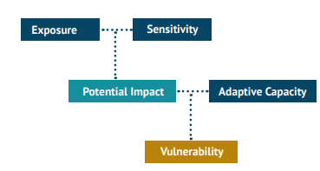
Identifying Priority Areas
The Intergovernmental Panel on Climate Change (IPCC; 2001) defines Vulnerability as “the degree to which a system is susceptible to, or unable to cope with, adverse effects of climate change, including climate variability and extremes.” It is a function of (1) the degree of the system’s Exposure to climate hazards; (2) its Sensitivity to such hazards; and (3) its Adaptive Capacity (IPCC, 2001)
Adapted from Alino et.al (2013) guidebook on Vulnerability Assessment Tools for Coastal Ecosystems
Notes:
So, how do we identify priority areas for reforestation? One good measure would be vulnerability. Vulnerability is a degree to which a system is susceptible to, or unable to cope with, adverse effects of climate change, including climate variability and extremes.”
It is a function of (1) the degree of the system’s Exposure to climate hazards; (2) its Sensitivity to such hazards; and (3) its Adaptive Capacity (IPCC, 2001)

Slide 7
Identifying Priority Areas
The Intergovernmental Panel on Climate Change (IPCC; 2001) defines Vulnerability as “the degree to which a system is susceptible to, or unable to cope with, adverse effects of climate change, including climate variability and extremes.” It is a function of (1) the degree of the system’s Exposure to climate hazards; (2) its Sensitivity to such hazards; and (3) its Adaptive Capacity (IPCC, 2001)
For this particular use case, the impact has already been experienced so we will be tailoring our factors towards Impact instead of Potential Impact which is a function of Exposure and Sensitivity.
Impact
Adaptive Capacity
Vulnerable Sites / Priority Areas
Adapted from Alino et.al (2013) guidebook on Vulnerability Assessment Tools for Coastal Ecosystems
Notes:
For this particular use case, the impact has already been experienced so we will be tailoring our factors towards Impact instead of Potential Impact which is a function of Exposure and Sensitivity. Instead of having a set of factors for exposure and sensitivity, we will just have to use factors for the impact of the typhoon.

Slide 8
Data Source
Impact
Focal Statistics
Raster
Shape
Update Attribute
Num
Number of Deaths
Damaged Communication Lines
Number of Injuries
Number of Damaged Houses
Normalize 1-5
Number of Missing People
Damage to Agriculture
Non-passable Roads
Damage to Infrastructure
Union
Non-passable Bridges
Distance from Path of Typhoon
Adaptive Capacity
Convert Total to LMH
City / Municipality
Green Band
Regional GDP
Change in Global Tree Cover
Provincial 4 Pillars
Change in Global Biomass Carbon
Calculate for Vulnerability
LMH
Land Cover
Global Human Modification
Notes:
In order to identify priority areas, we use this workflow. It is basically just an overlay analysis. This was not included in the submission but this may be helpful for my presentation today. First we gather what data we can use and we classify them according to what is considered as an impact or what can be considered as an adaptive capacity. So, we will be using the shapefile for the Philippines that has a regional boundary and as well as municipal or city level boundary.
Once we have our data, we classify them according to three, if we have a raster, we use focal statistics (Calculates for each input cell location a statistic of the values within a specified neighborhood around it.) to calculate for the average value of that certain raster against a city/municipality. If we have a shapefile, we just check the attribute table for its classification and if have a numerical value like statistical data for a certain city or municipality or a region we just update the attribute of that certain polygon. After that we normalize each of these factors into 1-5. This will help us make our data and analysis more manageable. Once we have normalized our data,, we perform a union. We then convert the total value for impact and adaptive capacity to low medium and high and once we have that we can then proceed and calculate for Vulnerability.
Let us go through each of our layers one by one.

Slide 9
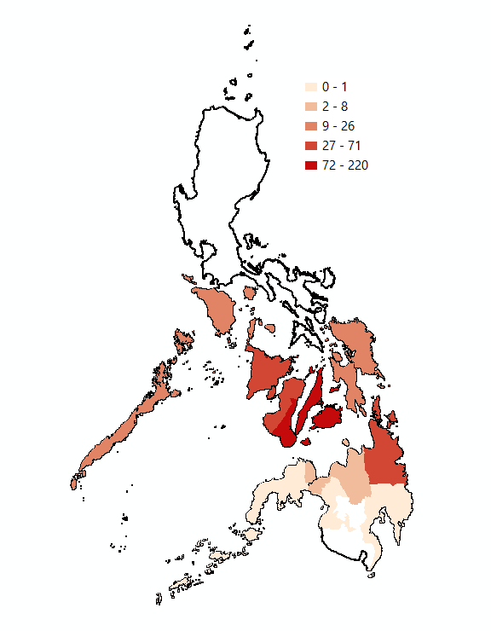
Impact
Here are the layers that are under the Impact factor of our analysis:
Number of Deaths
Notes:
These are the layers used for calculating the impact. Most of the values on this layer was retrieved from the National Disaster Risk Reduction’s monitoring dashboard.

Slide 10
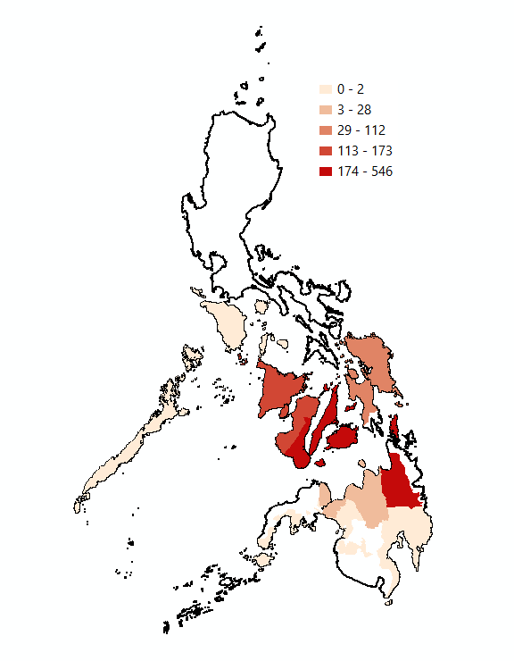
Impact
Here are the layers that are under the Impact factor of our analysis:
Number of Deaths
Number of Injuries

Slide 11
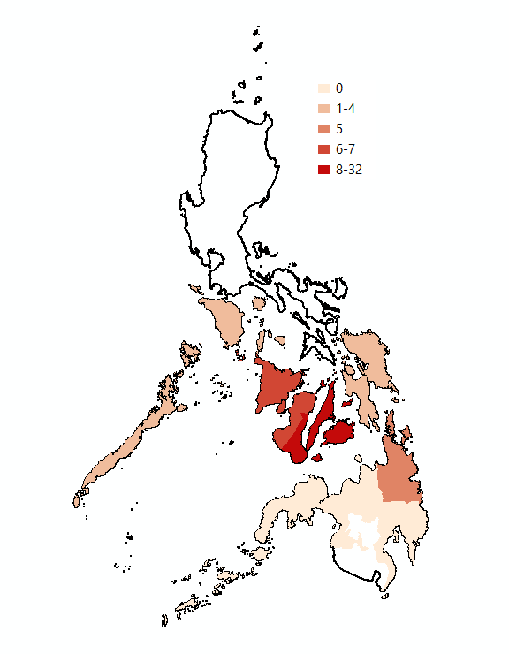
Impact
Here are the layers that are under the Impact factor of our analysis:
Number of Deaths
Number of Injuries
Number of Missing People

Slide 12
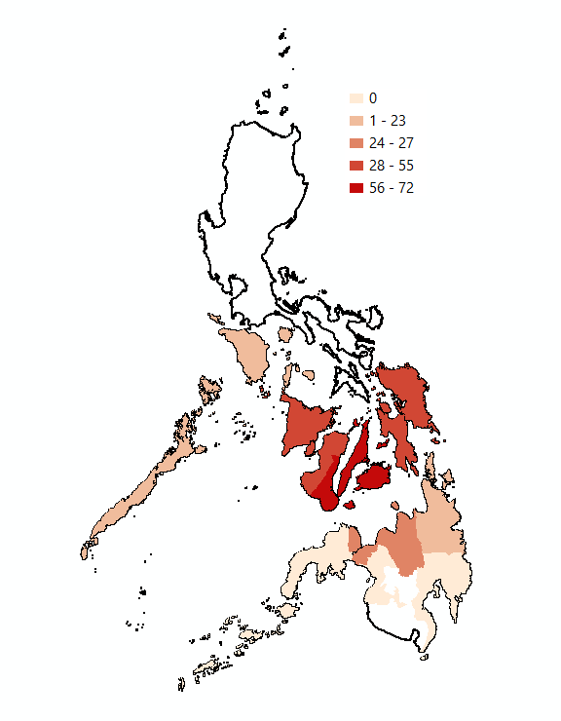
Impact
Here are the layers that are under the Impact factor of our analysis:
Number of Deaths
Number of Injuries
Number of Missing People
Non-passable Roads

Slide 13
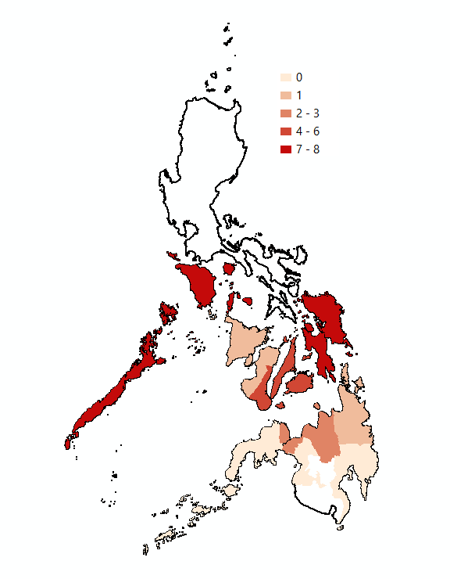
Impact
Here are the layers that are under the Impact factor of our analysis:
Number of Deaths
Number of Injuries
Number of Missing People
Non-passable Roads
Non-passable Bridges

Slide 14
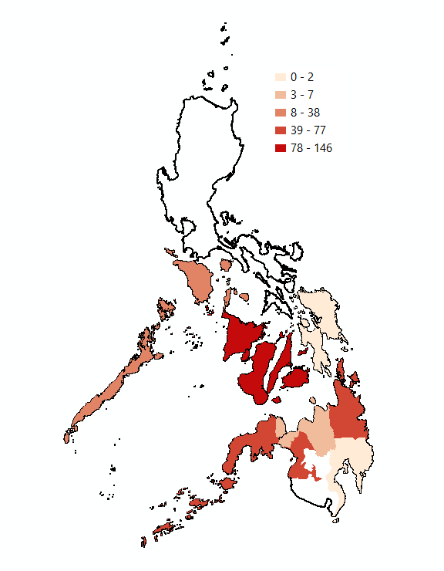
Impact
Here are the layers that are under the Impact factor of our analysis:
Number of Deaths
Damaged Communication Lines
Number of Injuries
Number of Missing People
Non-passable Roads
Non-passable Bridges

Slide 15
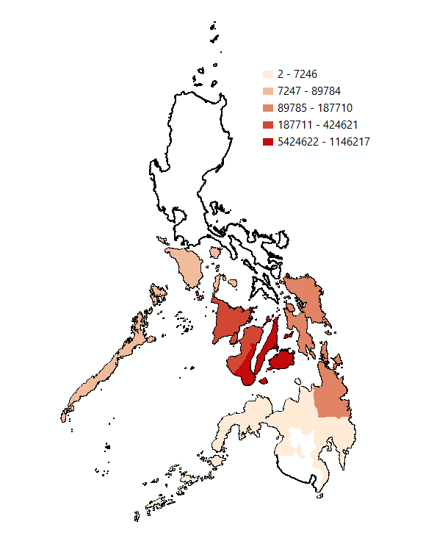
Impact
Here are the layers that are under the Impact factor of our analysis:
Number of Deaths
Damaged Communication Lines
Number of Injuries
Number of Damaged Houses
Number of Missing People
Non-passable Roads
Non-passable Bridges

Slide 16
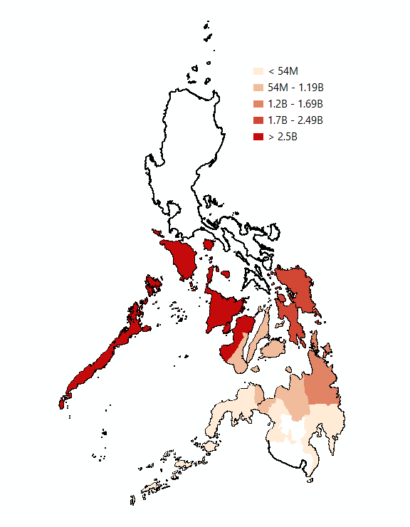
Impact
Here are the layers that are under the Impact factor of our analysis:
Number of Deaths
Damaged Communication Lines
Number of Injuries
Number of Damaged Houses
Number of Missing People
Damage to Agriculture
Non-passable Roads
Non-passable Bridges
Notes:
Damage to Agriculture in Pesos

Slide 17
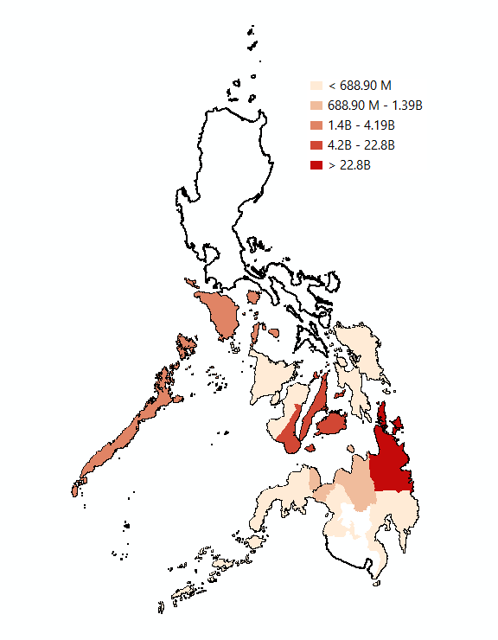
Impact
Here are the layers that are under the Impact factor of our analysis:
Number of Deaths
Damaged Communication Lines
Number of Injuries
Number of Damaged Houses
Number of Missing People
Damage to Agriculture
Non-passable Roads
Damage to Infrastructure
Non-passable Bridges
Notes:
Damage to Infrastructure in Pesos

Slide 18
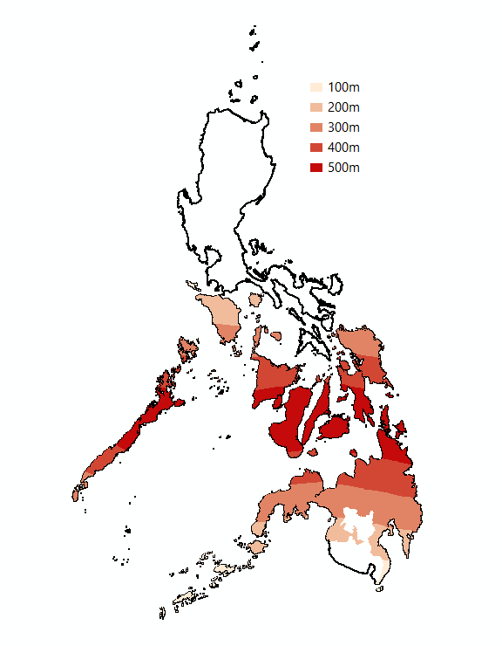
Impact
Here are the layers that are under the Impact factor of our analysis:
Number of Deaths
Damaged Communication Lines
Number of Injuries
Number of Damaged Houses
Number of Missing People
Damage to Agriculture
Non-passable Roads
Damage to Infrastructure
Non-passable Bridges
Distance from Path of Typhoon
Notes:
Distance from the Path of Typhoon

Slide 19
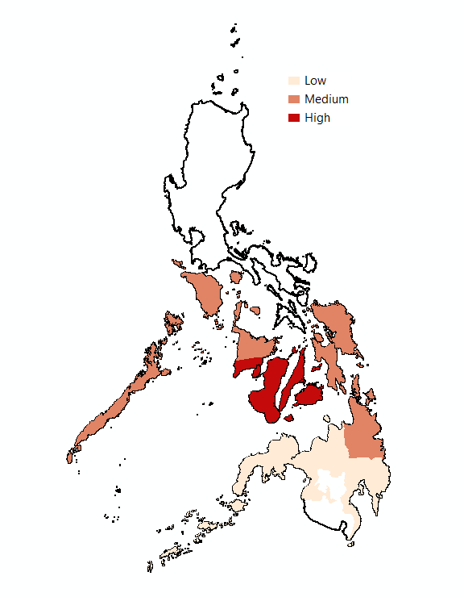
Impact
Here are the layers that are under the Impact factor of our analysis:
Number of Deaths
Damaged Communication Lines
Number of Injuries
Number of Damaged Houses
Number of Missing People
Damage to Agriculture
Non-passable Roads
Damage to Infrastructure
Non-passable Bridges
Distance from Path of Typhoon
Converted Impact Layer
This layer is a combination of all the data above, which was then normalized and categorized into Low Impact, Medium Impact and High Impact.

Slide 20
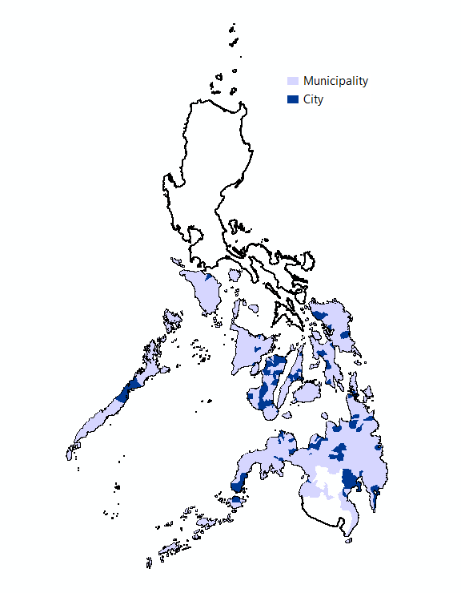
Adaptive Capacity
Here are the layers that are under the Adaptive Capacity factor of our analysis:
City / Municipality
Notes:
So a city due to its economic capability has a higher chance of recovering so a city was given a 5 while municipalities where a 3. This could be more detailed if we can incorporate the type of city or municipality in the scoring.

Slide 21
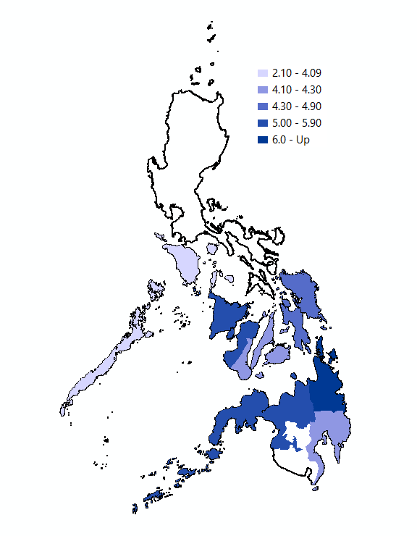
Adaptive Capacity
Here are the layers that are under the Adaptive Capacity factor of our analysis:
City / Municipality
Regional GDP
Notes:
The regional gross domestic product was accessed from PSA. The values were then divided into five classes.

Slide 22
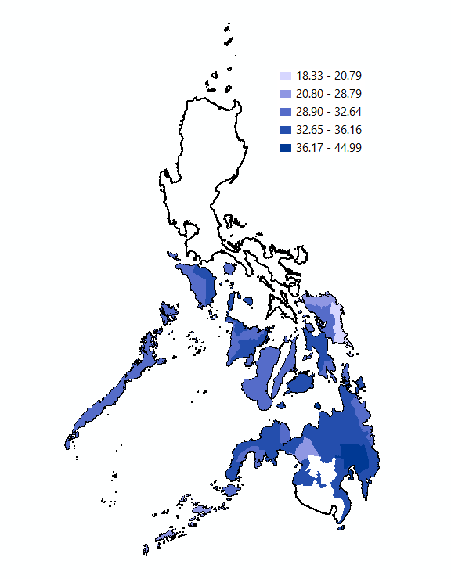
Adaptive Capacity
Here are the layers that are under the Adaptive Capacity factor of our analysis:
City / Municipality
Regional GDP
Provincial 4 Pillars
Notes:
This is a score derived from the Department of Trade and Industry. Rankings of Cities and Municipalities are based on the sum of their scores on 4 Pillars: Economic Dynamism, Government Efficiency, Infrastructure, and Resiliency. Provincial rankings are based on population and income weighted average of the Overall scores of cities and municipalities under a province. Provinces with higher scores have a greater value for their adaptive capacity.

Slide 23
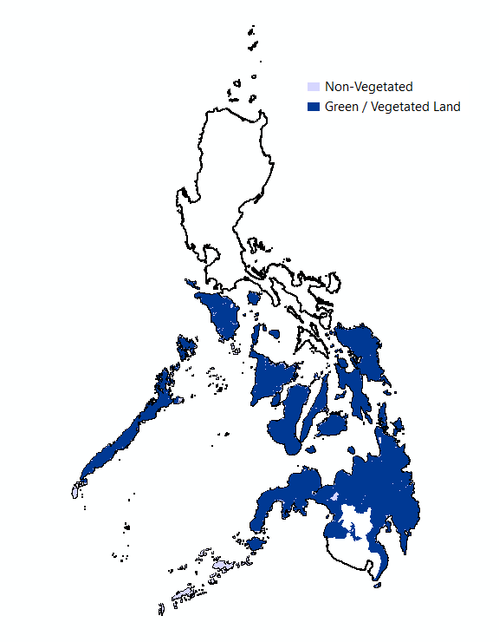
Adaptive Capacity
Here are the layers that are under the Adaptive Capacity factor of our analysis:
City / Municipality
Regional GDP
Provincial 4 Pillars
Land Cover
Notes:
The land cover data was from humdata.org, I haven’t assessed the reliability of the data yet but for now it is what I used. It is divided into a lot of categories such as arable lands, plantations, forest and built up. For now I have just group it into Vegetated and Non-Vegetated but hopefully if given the time, we can correctly classify each class based on adaptive capacity but for the sake of the exercise, we just used the two classes.

Slide 24
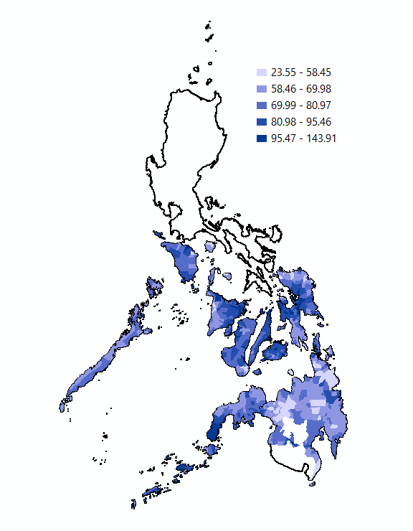
Adaptive Capacity
Here are the layers that are under the Adaptive Capacity factor of our analysis:
City / Municipality
Green Band
Regional GDP
Provincial 4 Pillars
Land Cover
Notes:
The value was extracted from ESRI RGB green band. I was trying to initially calculate for NDVI before and after Odette from Landsat imagery but I underestimated the space requirements for an image of that size so for now, I just used a green band of an image to somehow temporarily represent the level of vegetation in an area.

Slide 25
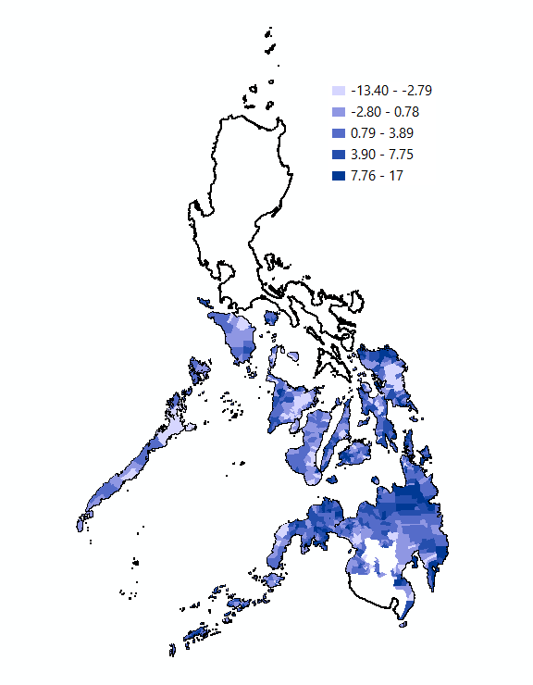
Adaptive Capacity
Here are the layers that are under the Adaptive Capacity factor of our analysis:
City / Municipality
Green Band
Regional GDP
Change in Global Tree Cover
Provincial 4 Pillars
Land Cover
Notes:
Proceed sd sa next since the same silage source

Slide 26

Adaptive Capacity
Here are the layers that are under the Adaptive Capacity factor of our analysis:
City / Municipality
Green Band
Regional GDP
Change in Global Tree Cover
Provincial 4 Pillars
Change in Global Biomass Carbon
Land Cover
Notes:
The Global Tree Cover and Biomass Carbon on Agricultural Land Database provides raster data describing percent tree cover and above- and below-ground biomass carbon on agricultural land, globally, at a resolution of 1 km² (30 arc seconds in geographic coordinates, as provided for online data distribution), for the period 2000 to 2010.

Slide 27
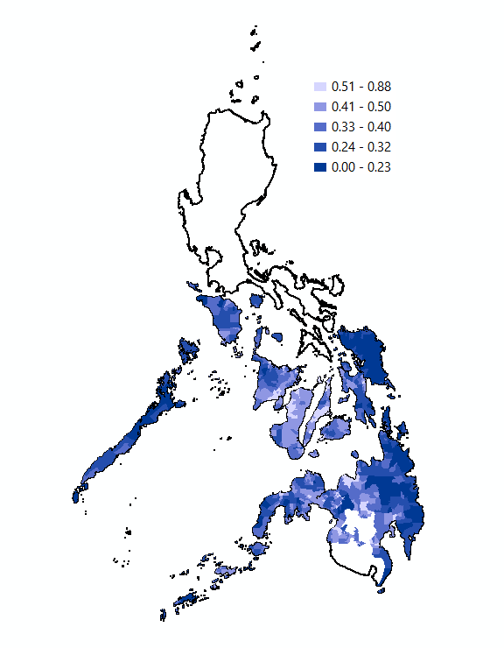
Adaptive Capacity
Here are the layers that are under the Adaptive Capacity factor of our analysis:
City / Municipality
Green Band
Regional GDP
Change in Global Tree Cover
Provincial 4 Pillars
Change in Global Biomass Carbon
Land Cover
Global Human Modification
Notes:
To provide a cumulative measure of human modification of terrestrial lands based on modeling the physical extents of 13 anthropogenic stressors and their estimated impacts using spatially-explicit global data sets. The higher the modification, the smaller the adaptive capacity.

Slide 28
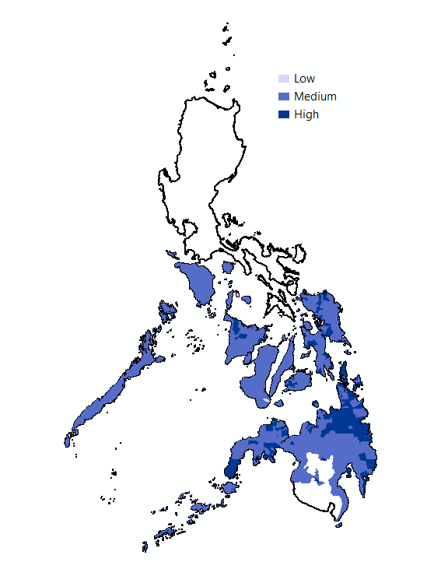
Adaptive Capacity
Here are the layers that are under the Adaptive Capacity factor of our analysis:
City / Municipality
Green Band
Regional GDP
Change in Global Tree Cover
Provincial 4 Pillars
Change in Global Biomass Carbon
Land Cover
Global Human Modification
Converted Adaptive Capacity Layer
This layer is a combination of all the data above, which was then normalized and categorized into Low Adaptive Capacity, Medium Adaptive Capacity and High Adaptive Capacity.

Slide 29
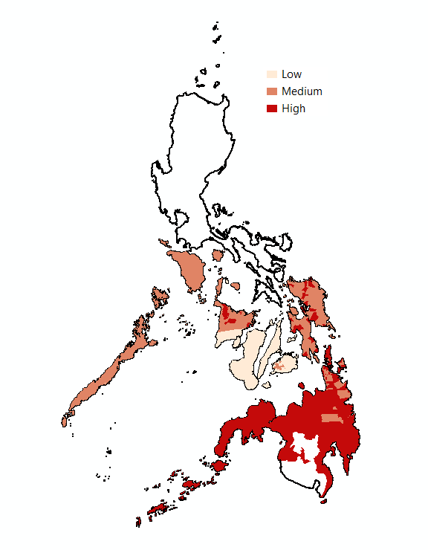
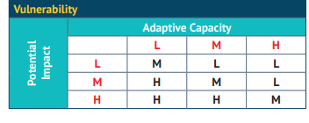
Potential Sites
Candidate sites for reforestation can be estimated by cross referencing impact and adaptive capacity layers as per the table below.

Slide 30

Potential Sites
!
Laoang
!
Makato
Tabango
!
!
Dapa
!
Sagay
!
Candidate sites for reforestation can be estimated by cross referencing impact and adaptive capacity layers as per the table below.
Notes:
Based on the my submission and results we can see the most vulnerable sites are the ones in Mindanao and a few portions of Panay Island as well as Samar, Leyte and Southern Leyte.

Slide 31
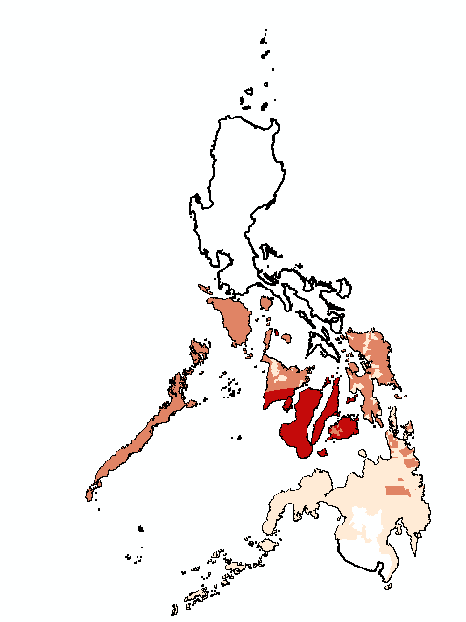
Potential Sites
!
Sibalom
!
Ayungon
Anda
!
!
Candidate sites for reforestation can be estimated by cross referencing impact and adaptive capacity layers as per the table below.
Notes:
However that analysis was incorrect. There were issues when creating the function, I incorrectly passed the parameter. I apologise for that.
Based on this corrected analysis, the vulnerability was greater around central Visayas and portions of western Visayas. And medium vulnerability on Palawan, the rest of panay island, leyte, southern leyte and samar. We can see medium vulnerability as well in Portions of CARAGA Region. From this vulnerable areas, we can create potential sites, we can overlay this with an existing tree cover dataset which I currently do not have but may acquire in the future.
It is a great initiative to reforest trees after Typhoon Odette because personally for me they are a reminder to be hopeful.
During the pandemic my father planted malunggay on an empty water bottle the one we use for dispenses, it was on top of our roof but due to the typhoon the malunggay disappeard but I was left with what seems to be a root like a huge clump of bark or like big overlapping potato. I decided to just leave it on another pot with soil. Funny thing, after I was released from the isolation center (because I also got covid) and cannot home quarantine because there is no water and electricity at home. The malunggay sprouted baby leaves during the last week of January this year. It is now thriving about 6ft tall but only like 1.5cm diameter. But I guess we could say that trees are a lot more resilient to something that they are meant to experience like Typhoons but it is now a question of whether or not Typhoons are still natural when it comes unprecedented and at a varied rate as compared before. I guess, what I want to imply is that it is great that there are efforts to plant trees, but efforts shall not only be focused on planting trees but towards preserving these ecosystems at a larger scale and a much violent threat such as probably humans.
Trees don’t only serve as means of beautification; they play an essential role in environmental sustainability. Hopefully just like our baby malunggay tree, I hope this presentation gave you a little hope that someday nature can recover.

Slide 32
Impact
Adaptive Capacity
Submitted Output

Slide 33
Impact
Adaptive Capacity
Corrected Output

Slide 34
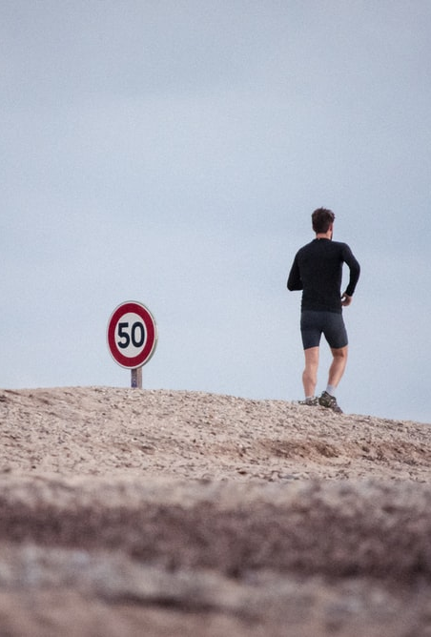
Scope and Limitations
Further information about the data can be found on the submitted data set guide file.
Only limited analysis has been made on the number of factors and the factors involved due to the time constraint.
Most adaptive capacity values are geared towards forest cover in order to have an estimate or partial representation of the environment’s ability to adapt.
Most impact values are based on the report from NDRRMC and the quality and the accuracy of the datasets as well as the overlay analysis has not been analyzed for possible errors
NDVI can be used but due to the large nature of the study area, the presenter wasn’t able to download it since the drive space cannot contain the NDVI pre and post typhoon.
Guillaume de Germain (February 22, 2016)
Notes:
Guillaume de Germain (February 22, 2016)
https://unsplash.com/photos/h1itWfWeQM4
I su

Slide 35
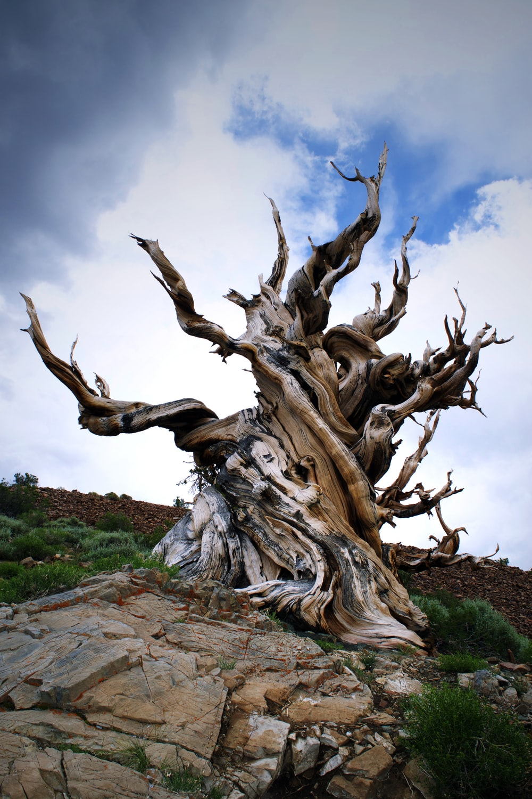
Recommendations
Educate people on how to inspect the health of the tree. For example, checking for weakened structural integrity. Most of the structural damages in homes were caused by strong winds and as well as trees falling into the houses.
Normalized Difference Vegetation Index can be a useful layer in this analysis (personnel may need larger cloud storage).
On the ground data and as well as community interviews can be a good input into the analysis and would somehow supplement and validate the analysis from remotely sensed data.
Tree species dataset can be helpful in the analysis.
Notes:
Juvian Duff ( April 6, 2019)
https://unsplash.com/photos/x_mdcjGHnUI

